Slide 1
CS 6109 Compiler Design
By
Dr. Mrs. Arockia Xavier Annie R
Asst. Professor, Dept. of Computer Science and Engineering,
CEG, Anna University,
Chennai -600025.
Email: aucs.annie@gmail.com/ annie@annauniv.edu

Slide 2
Compiler Course Objectives
To understand, design and implement a lexical analyzer.
To understand, design and implement a parser.
To understand and design code generation schemes.
To understand optimization of codes and runtime environment.
Learn how to work on a larger software project.

Slide 3
Motivation
As a Discipline involves the Application of a wide range of Multiple CS & E
Compiler writing spans:
Data Structures
Programming Languages & Algorithms
Computer Architecture & Operating Systems
Language theory
Software engineering
Theoretical Techniques
Good SE experience
Better understanding of programming languages

Slide 4
Features of compilers
Correctness
Speed of target code
Speed of compilation
Good error reporting/handling
Cooperation with the debugger
Support for separate compilation

Slide 5
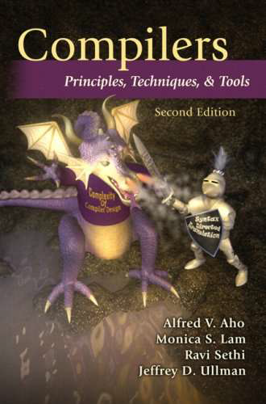
Bibliography
Textbook:
Compilers: Principles, Techniques and Tools, Aho, Lam, Sethi & Ullman, 2007 (required)
References:
Randy Allen, Ken Kennedy, “Optimizing Compilers for Modern Architectures:
A Dependence-based Approach”, Morgan Kaufmann Publishers, 2002
Steven S. Muchnick, Advanced Compiler Design and Implementation”,
Morgan Kaufmann Publishers - Elsevier Science, India, Indian Reprint 2003.
3. Keith D Cooper and Linda Torczon, “Engineering a Compiler”, Morgan
Kaufmann Publishers Elsevier Science, 2004.
4. Charles N. Fischer, Richard J LeBlanc, “Crafting a Compiler with C”
Pearson Education, 2008.

Slide 6
A Brief History on Compilers

Slide 7
Why Compiler ?
Writing machine language numeric codes is time consuming and tedious
Operation Register Tag Memory Address
0001 01 00 0000 0000 (load) 0001 01 00 0000 0000
0011 01 10 0000 0010 (add) 0011 01 10 0000 0010
0010 01 00 0000 0100 (store) 0010 01 00 0000 0100
The assembly language has a number of defects
Not easy to write
Difficult to read and understand
C7 06 0000 0002
Mov x, 2
X=2

Slide 8
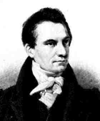
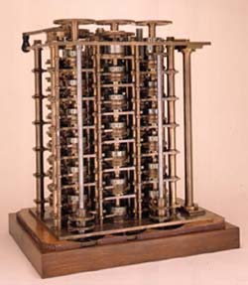

Computing in the beginning of time
the man...
... the legend
and this
is only
a small
part of
the machine!
the programmer
how do you program this??
Changing Gears!
Charles Babbage
The Difference Engine” (1822)
Lady Ada of Lovelace

Slide 9
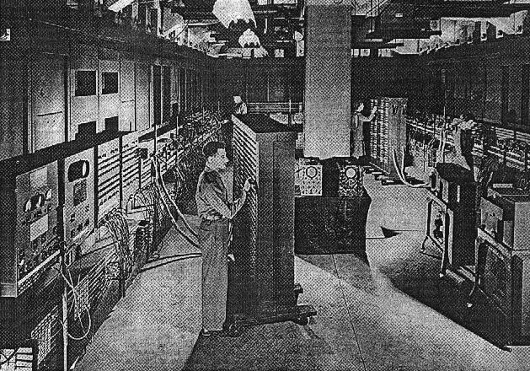
Computers!
Electronic Numerical Integrator and Computer --- ENIAC, 1942
how do you program this?? Flicking Switches!

Slide 10
Timeline
1940’s.
Code is hand generated at 0 -1 level and entered by physical switches
Hardware is rewired according to the program
Early 1950’s. First attempts to abstraction. Grace Murray Hopper:
“translation is a compilation of a sequence of machine-language subprograms selected from a library.”
first “compiler” A-0 (by G. M. Hopper)
Code now is written in Assembly form.
Late 1950’s. FORTRAN is born together with its Compiler!!!

Slide 11
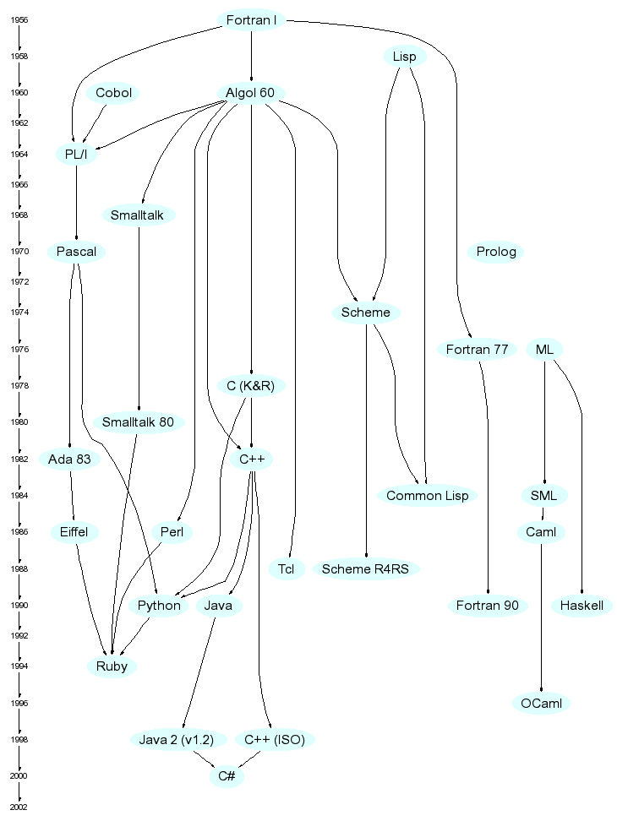
diagram from http://merd.net/pixel/language-study/diagram.html

Slide 12
1960’s
ALGOL 60
The first Language with a formal grammar specification
FORTRAN gets improved.
Language theory is better understood, it evolves and revolutionizes compiler design.
First “Syntax-Directed Compiler” is born in 1961.
PASCAL is born (Wirth, 1968).
First attempts at automating compiler construction using elements of Formal Language Theory.

Slide 13
The 1970’s, 80’s, 90’s
C programming Language is born with its compiler (1972). Distributed as part of the UNIX operating system.
BASIC is born (1975).
“Compiler-Compiler” Tools start to be developed and used extensively.
Success of PCs brings compilers and interpreters in everyone’s home.

Slide 14
Compiler Creation
Past:
1950: the first FORTRAN compiler took 18 man-years
The FORTRAN language and its compiler by a team at IBM led by John Backus
Present:
Using software tools, can be done in a few months as a student’s project

Slide 15
Application
Compilers are everywhere.
“Programming” is only one application domain...
TeX and LaTeX
language source is compiled into a document.
Postscript
language source is translated by laser printers to printer machine level instructions that print a document.
Mathematica / Matlab
use a language to specify mathematical operations.
Verilog / VHDL
compiles into a circuit

Slide 16
Other Applications
In addition to the development of a compiler, the techniques used in compiler design can be applicable to many problems in computer science.
Techniques used in a lexical analyzer can be used in text editors, information retrieval system, and pattern recognition programs.
Techniques used in a parser can be used in a query processing system such as SQL.
Many software having a complex front-end may need techniques used in compiler design.
Eg. symbolic equation solver which takes an equation as input. That program should parse the given input equation.
Most of the techniques used in compiler design can be used in Natural Language Processing (NLP) systems.

Slide 17
What is a Translator?
A program that reads a program written in one language and translates it into another language.
Source language Target language
Traditionally, compilers go from high-level languages to low-level languages.
Translator

Slide 18
Language Processing & Compiler

Slide 19
Language Processing System
Skeletal Source Program
Preprocessor
Source Program
Compiler
Target Assembly Program
Assembler
Relocatable Object Code
Libraries and
Relocatable Object Files
Linker/Loader
Absolute Machine Code

Slide 20
Preprocessors
Delete comments, include other files, and perform macro substitutions
Required by a language (as in C) or can be later add-ons that provide additional facilities

Slide 21
Assemblers
A translator for the assembly language of a particular computer
Assembly language is a symbolic form of one machine language
A compiler may generate assembly language as its target language and an assembler completes the translation into object code

Slide 22
Assemblers (cont’d)
Assembly code: names are used for instructions, and names are used for memory addresses.
Two-pass Assembly:
First Pass: all identifiers are assigned to memory addresses (0-offset) e.g. substitute 0 for a, and 4 for b
Second Pass: produce relocatable machine code:
MOV a, R1
ADD #2, R1
MOV R1, b
Load
Store
add
0001 01 00 00000000 *
0011 01 10 00000010
0010 01 00 00000100 *
relocation
bit

Slide 23
Linkers
Collect separate object files into a directly executable file
Connect an object program to the code for standard library functions and to resource supplied by OS
Becoming one of the principle activities of a compiler, depends on OS and processor
Linker: taking many (relocatable) machine code programs (with cross-references) and produce a single file.
Need to keep track of correspondence between variable names and corresponding addresses in each piece of code.

Slide 24
Loaders
Resolve all re-locatable address relative to a given base
Make executable code more flexible
Often as part of the operating environment, rarely as an actual separate program
Loader: taking relocatable machine code, altering the addresses and placing the altered instructions into memory.

Slide 25
Compilers
“Compilation”
Translation of a program written in a source language into a semantically equivalent program written in a target language
Source
Program
Compiler
Target
Program
( Normally a program written in
a high-level programming language)
Error messages
Output
( Normally the equivalent program in
machine code – relocatable object file)

Slide 26
Compilers and Interpreters
“Interpretation”
Performing the operations implied by the source program
Execute the source program immediately rather than generating object code
Examples: BASIC, LISP, Python used often in educational or development situations
Speed of execution is slower than compiled code by a factor of 10 or more
Better error diagnostics than compiler
Source
Program
Interpreter
Output
Input
Error messages

Slide 27
S.No | Compiler | Interpreter
1 | Compiler Takes Entire program as input | Interpreter Takes Single instruction as input .
2 | Intermediate Object Code is Generated | No Intermediate Object Code is Generated
3 | Conditional Control Statements are Executes faster | Conditional Control Statements are Executes slower
4 | Memory Requirement : More (Since Object Code is Generated) | Memory Requirement is Less
5 | Program need not be compiled every time | Every time higher level program is converted into lower level program
6 | Errors are displayed after entire program is checked | Errors are displayed for every instruction interpreted (if any)
7 | Example : C Compiler | Example : BASIC, Perl, Python Java script etc.,

Slide 28
Hybrid Compiler
Hybrid Compiler
Combines Compilation and Interpretation eg. Java
Source
Program
Translator
Intermediate
Program
Virtual
Machine
Output
Input

Slide 29
Hybrid Compiler
Compile-time Environment
Compile-time Environment
Class Loader
Bytecode
Verifier
Java Class
Libraries
Java
Source
(.java)
Just-in-Time
Compiler
( Java Interpreter )
Java
Bytecodes
move locally
or through
network
Java
Compiler
(javac)
Java Virtual
Machine
Runtime System
Java
Bytecode
(.class )
Operating System
Hardware

Slide 30
Editors
Compilers have been bundled together with editor and other programs into an interactive development environment (IDE)
Oriented toward the format or structure of the programming language, called structure-based
May include some operations of a compiler, informing some more errors

Slide 31
Debuggers
Used to determine execution error in a compiled program
Keep tracks of most or all of the source code information
Halt execution at pre-specified locations called breakpoints
Must be supplied with appropriate symbolic information by the compiler

Slide 32
Qualities of a Compiler (1/2)
Correct: the meaning of sentences must be preserved
Robust: wrong input is the common case
compilers and interpreters can’t just crash on wrong input
they need to diagnose all kinds of errors safely and reliably

Slide 33
Qualities of a Compiler (2/2)
Efficient: resource usage should be minimal in two ways
the process of compilation or interpretation itself is efficient
the generated code is efficient when interpreted
Usable: integrate with environment, accurate feedback
work well with other tools(editors, linkers, debuggers, . . )
descriptive error messages, relating accurately to source

Slide 34
Architecture of Compiler

Slide 35
The Analysis-Synthesis Model of Compilation
There are two parts to compilation:
Analysis determines the operations implied by the source program which are recorded in a tree structure
Synthesis takes the tree structure and translates the operations therein into the target program

Slide 36
Tools that Use the Analysis-Synthesis Model
Structure Editors (syntax highlighting)
Pretty printers (e.g. Doxygen)
Static checkers (e.g. Lint and Splint)
Interpreters(e.g.Perl, Matlab, Python, Jscript)
Text formatters (e.g. TeX and LaTeX)
Silicon compilers (e.g. VHDL)
Query interpreters/compilers (Databases)

Slide 37
Tools that Use the Analysis-Synthesis Model (1/4)
Today: There are many Software Tools for helping with the Analysis part.
Structure / Syntax directed editors: Force “syntactically” correct code to be entered
Takes input as a sequence of commands to build a source program.
Performs:
Text-creation
Text modifications
Analyzes the source program

Slide 38
Tools that Use the Analysis-Synthesis Model (2/4)
Pretty Printers: Standardized version for program structure (i.e., blank space, indenting, etc.)
Analyzes the source program and prints it in such a way that the structure of the program becomes clearly visible.
Examples
Comments may appear in a special font
Statements may appear with an amount of indentations proportional to the depth of their nesting in a hierarchical organization of the stmts.

Slide 39
Tools that Use the Analysis-Synthesis Model (3/4)
Static Checkers: A “quick” compilation to detect rudimentary errors
Examples
Detects parts of the program that can never be executed
A variable used before it is defined
Interpreters: “real” time execution of code: “line-at-a-time”

Slide 40
Tools that Use the Analysis-Synthesis Model (4/4)
Compilation Is Not Limited to Programming Language Applications
Text Formatters
LATEX & TROFF Are Languages Whose Commands Format Text ( paragraphs, figures, mathematical structures etc)
Silicon Compilers
Textual/Graphical: Take Input and Generate Circuit Design
Database Query Processors
Database Query Languages Are Also a Programming Language
Input is compiled Into a Set of Operations for Accessing the Database

Slide 41
The Many Phases of a Compiler
Source Program
1
Lexical Analyzer
2
Syntax Analyzer
3
Semantic Analyzer
Symbol-table Manager
Error Handler
4
Intermediate Representation
5
Code Optimizer
6
Code Generator
Target Program

Slide 42
The Analysis Task For Compilation
Linear / Lexical Analysis:
L-to-R Scan to Identify Tokens token: sequence of chars having a collective meaning
Hierarchical Analysis:
Grouping of Tokens Into Meaningful Collection
Semantic Analysis:
Checking to ensure Correctness of Components

Slide 43
Phase 1. Lexical Analysis
Easiest Analysis - Identify tokens which are the basic building blocks
For Example:
Position := initial + rate * 60 ;
_______ __ _____ _ ___ _ __ _
All are tokens
Blanks, Line breaks, etc. are scanned out

Slide 44
Phase 2. Hierarchical Analysis Parsing or Syntax Analysis
For previous example,
we would have
Parse Tree:
assignment statement
:=
identifier
expression
+
position
expression
expression
*
identifier
expression
expression
initial
identifier
number
rate
60
Nodes of tree are constructed using a grammar for the language

Slide 45
What is a Grammar?
Grammar is a Set of Rules Which Govern the Interdependencies & Structure Among the Tokens
statement
is an
assignment statement, or while statement, or
if statement, or ...
assignment statement
is an
identifier := expression ;
expression
(expression), or
expression + expression, or expression * expression, or number, or
identifier, or ...
is an

Slide 46
Why Have We Divided Analysis in This Manner?
Lexical Analysis - Scans Input, Its Linear Actions Are Not Recursive
Identify Only Individual “words” that are the the Tokens of the Language
Recursion Is Required to Identify Structure of an Expression, As Indicated in Parse Tree
Verify that the “words” are Correctly Assembled into “sentences”
What is Third Phase?
Determine Whether the Sentences have One and Only One Unambiguous Interpretation
e.g. “John Took Picture of Mary Out on the Patio”, 24

Slide 47
Phase 3. Semantic Analysis
Find More Complicated Semantic Errors and Support Code Generation
Parse Tree Is Augmented With Semantic Actions
:=
:=
position
+
position
+
initial
*
initial
*
rate
inttoreal
rate
60
60
Compressed Tree
Conversion Action

Slide 48
Phase 3. Semantic Analysis
Most Important Activity in This Phase:
Type Checking - Legality of Operands
Many Different Situations:
Example:
1. real := int + char ;
2. A[int] := A[real] + int ;
while char <> int do
…. Etc.

Slide 49
Phase 4: Intermediate Code Generation
The data passed between the analysis and synthesis phases is called the intermediate representation (IR) of the program
IR facilitates the independence of the analysis and synthesis (front and back-end) phases.
IR may be
assembly language like or
be an abstract syntax tree.
Example:
temp1 := inttoreal(60)
temp2 := id3 * temp1
temp3 := id2 + temp2
id1 := temp3

Slide 50
Phase 4: Intermediate Code Generation
A compiler may produce an explicit intermediate code representing the source program.
These intermediate codes are generally machine (architecture independent). But the level of intermediate codes is close to the level of machine codes.
Ex:
newval := oldval * fact + 1
id1 := id2 * id3 + 1
MUL id2,id3,temp1 Intermediates Codes (Quadruples)
ADD temp1,#1,temp2
MOV temp2,,id1

Slide 51
Phase 5: Code Optimizer (1/3)
Goal is to Improve Performance
Speed
Code Size
Power Consumption
Fast/Efficient Compilation
Security/Reliability
Debugging

Slide 52
Phase 5: Code Optimizer (2/3)
The earliest point of most optimization steps is just after semantic analysis
The code improvement depends only on the source code, and as a separate phase
Individual compilers exhibit a wide variation in optimization kinds as well as placement
The code optimizer optimizes the code produced by the intermediate code generator in the terms of time and space.

Slide 53
Phase 5: Code Optimizer (3/3)
COMPILER FRONT END
It improves the target code generated by the code generator:
Address modes choosing
Instructions replacing
As well as redundant eliminating
Ex.
MULT id2,id3,temp1
ADD temp1,#1,id1
Intermediate-code Generator
Non-optimized Intermediate Code
Intermediate-code Optimizer
Optimized Intermediate Code
Target-code Generator
Optimized Target machine code

Slide 54
Phase 6: Code Generator
Generate Relocatable Machine Dependent Code
This phase generates the target code consisting of assembly code.
Memory locations are selected for each variable
Instructions are translated into a sequence of assembly instructions
Variables and intermediate results are assigned to memory registers.
Ex. ( assume that we have an architecture with instructions whose at least one of its operands is a machine register)
MOVF id3, R2 The F stands for floating-point instruction
MULF #60.0, R2 The # means that 60.0 is a constant
MOVF id2, R1 The first and second operand of each instruction
ADDF R2, R1 Specify a source and a destination
MOVF R1, id1

Slide 55
Supporting Phases / Activities for Analysis
Symbol Table Creation / Maintenance
Contains Info (storage, type, scope, args) on Each “Meaningful” Token, Typically Identifiers
Data Structure Created / Initialized During Lexical Analysis
Utilized / Updated During Later Analysis & Synthesis
Error Handling
Detection of Different Errors Which Correspond to All Phases
What Kinds of Errors Are Found During the Analysis Phase?
What Happens When an Error Is Found?

Slide 56
Reviewing the Entire Process
position := initial + rate * 60
lexical analyzer
id1 := id2 + id3 * 60
syntax analyzer
:=
id1
+
id2
*
id3
60
semantic analyzer
:=
Symbol Table
id1
+
Errors
id2l
*
position ....
initial ….
rate….
id3
inttoreal
60
intermediate code generator

Slide 57
Reviewing the Entire Process (cont’d)
Symbol Table
Errors
position ....
initial ….
rate….
intermediate code generator
temp1 := inttoreal(60)
temp2 := id3 * temp1
temp3 := id2 + temp2
id1 := temp3
3 address code
code optimizer
temp1 := id3 * 60.0
id1 := id2 + temp1
final code generator
MOVF id3, R2
MULF #60.0, R2
MOVF id2, R1
ADDF R2, R1
MOVF R1, id1

Slide 58
Compiler Cousins
Provides Input to Compilers
Macro processing
File Inclusion
Rational preprocessors
Language Extensions

Slide 59
1. Macro Processing
#define in C: does text substitution before compiling
#define X 3
#define Y A*B+C
#define Z getchar()

Slide 60
2. File Inclusion
#include in C - bring in another file before compiling
defs.h
main.c
#include “defs.h”
…---…---…---
…---…---…---
…---…---…---
//////
//////
//////
//////
//////
//////
…---…---…---
…---…---…---
…---…---…---

Slide 61
3. Rational Preprocessors
Augment “Old” Languages With Modern Constructs
Add Macros for If - Then, While, Etc.
#Define Can Make C Code More Pascal-like
#define begin {
#define end }

Slide 62
4. Language Extensions for a Database System
SEQUEL - Database query language embedded in C
## Retrieve (DN = Department.Dnum) where
## Department.Dname = ‘Research’
is Preprocessed into:
ingres_system(“Retr…..Research’”,____,____);
a procedure call in a programming language.

Slide 63
The Grouping of Phases
Front End : Analysis + Intermediate Representation (IR) Generation ( source language dependent)
Back End : Code Generation + Code Optimization (machine dependent)
Intermediate Language
Source
Language
Front End
language specific
Back End
machine specific
Target Language
Separation of Concerns
Retargeting

Slide 64
Compiler Passes
Compiler passes:
A collection of phases is done only once (single pass) or multiple times (multi pass)
Single pass: usually requires everything to be defined before being used in source program
Multi pass: compiler may have to keep entire program representation in memory

Slide 65
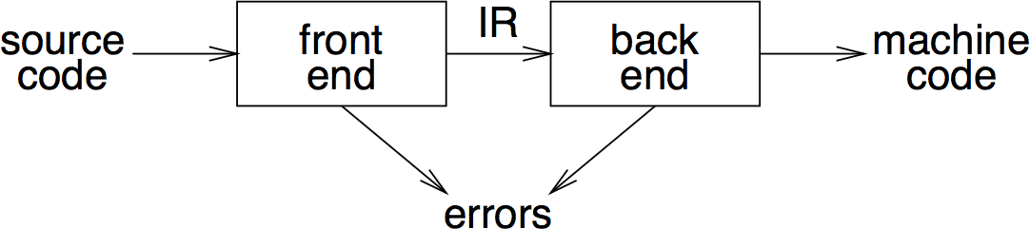
Traditional two pass compiler
intermediate representation (IR)
front end maps legal code into IR
back end maps IR onto target machine
simplify retargeting
allows multiple front ends
multiple passes ⇒ better code

Slide 66
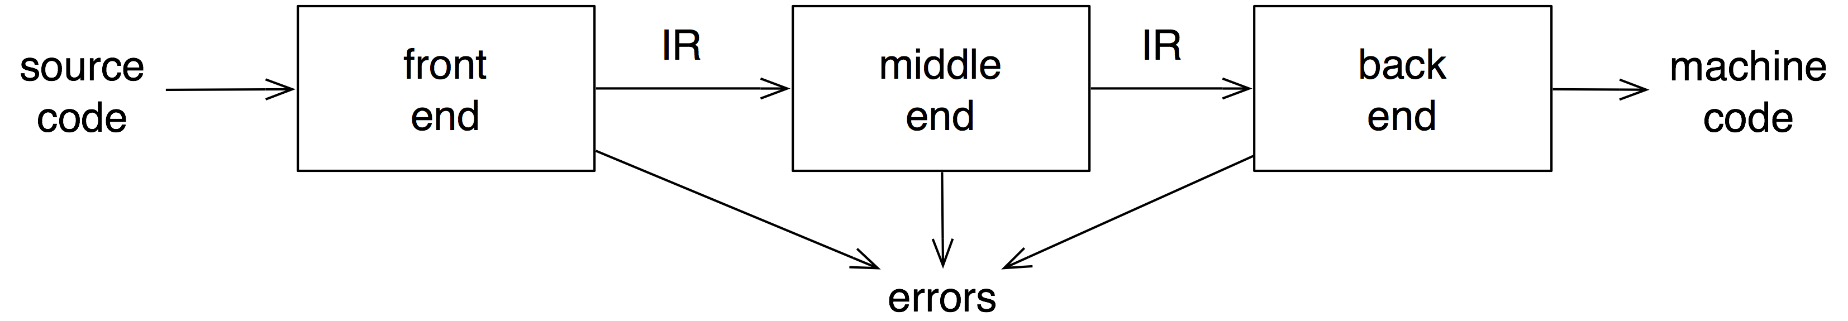
Traditional three pass compiler
analyzes and changes IR
goal is to reduce runtime
must preserve values

Slide 67
Recap

Slide 68
Compiler Phases
Phase | Output | Sample
Programmer (source code producer) | Source string | A = B + C;
Scanner (performs lexical analysis) | Token string | ‘A’, ‘=’, ‘B’, ‘+’, ‘C’, ‘;’ And symbol table with names
Parser (performs syntax analysis based on the grammar of the programming language) | Parse tree or abstract syntax tree | ; | = / \ A + / \ B C
Semantic analyzer (type checking, etc) | Annotated parse tree or abstract syntax tree
Intermediate code generator | Three-address code, quads, or RTL | int2fp B t1 + t1 C t2 := t2 A
Code Optimizer | Three-address code, quads, or RTL | int2fp B t1 + t1 #2.3 A
Code generator | Assembly code | MOVF #2.3,r1 ADDF2 r1,r2 MOVF r2,A
Peephole optimizer | Assembly code | ADDF2 #2.3,r2 MOVF r2,A

Slide 69
What you should know!
What is the difference between a compiler and an interpreter?
What are important qualities of compilers?
Why are compilers commonly split into multiple passes?
What are the typical responsibilities of the different parts of a modern compiler?
How are context-free grammars specified?
What is “abstract” about an abstract syntax tree?
What is intermediate representation and what is it for?
Why is optimization a separate activity?

Slide 70
Questions ???

